Slide 1
OBSERVATION
Based on the five senses
Sight
Smell
Touch
Taste
Hearing

Slide 2
INFERENCE
Based on:
Prior knowledge
Past experience

Slide 3

PREDICTION
Based on all input, you make a guess about the future

Slide 4
OBSERVATION, INFERENCE, OR PREDICTION?
The bell is ringing

Slide 5
OBSERVATION

Slide 6
OBSERVATION, INFERENCE, OR PREDICTION?
The flower has red petals

Slide 7
OBSERVATION

Slide 8
OBSERVATION, INFERENCE, OR PREDICTION?
The boy has tears in his eyes, so I think he is is sad

Slide 9
INFERENCE

Slide 10
OBSERVATION, INFERENCE, OR PREDICTION?
The dog is going to burp

Slide 11
PREDICTION

Slide 12
OBSERVATION, INFERENCE, OR PREDICTION?
There is a lot of red in the painting, so I think the artist was mad

Slide 13
INFERENCE

Slide 14
OBSERVATION, INFERENCE, OR PREDICTION?
The cell phone is making a noise

Slide 15
OBSERVATION

Slide 16
OBSERVATION, INFERENCE, OR PREDICTION?
The quiz is going to be easy

Slide 17
PREDICTION

Slide 18
OBSERVATION, INFERENCE, OR PREDICTION?
The dog has 3 legs

Slide 19
OBSERVATION

Slide 20
OBSERVATION, INFERENCE, OR PREDICTION?
The kids are smiling so I think they are happy

Slide 21
INFERENCE

Slide 22
OBSERVATION, INFERENCE, OR PREDICTION?
My mom is angry

Slide 23
INFERENCE

Slide 24
OBSERVATION, INFERENCE, OR PREDICTION?
I am going to do all my homework

Slide 25
PREDICTION

Slide 26
OBSERVATION, INFERENCE, OR PREDICTION?
The cat is closing its eyes so I think it’s dead

Slide 27
INFERENCE

Slide 28
OBSERVATION, INFERENCE, OR PREDICTION?
The cat is on top of the table

Slide 29
OBSERVATION

Slide 30
OBSERVATION, INFERENCE, OR PREDICTION?
The fire is moving

Slide 31
OBSERVATION

Slide 32
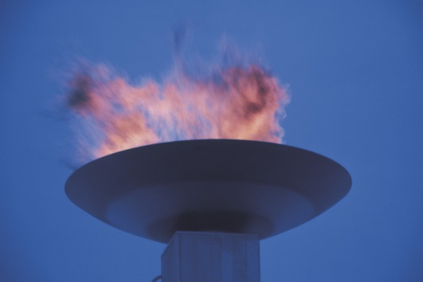
OBSERVATION, INFERENCE, OR PREDICTION?
The fire might be alive because there are red coals.

Slide 33
INFERENCE

Slide 34
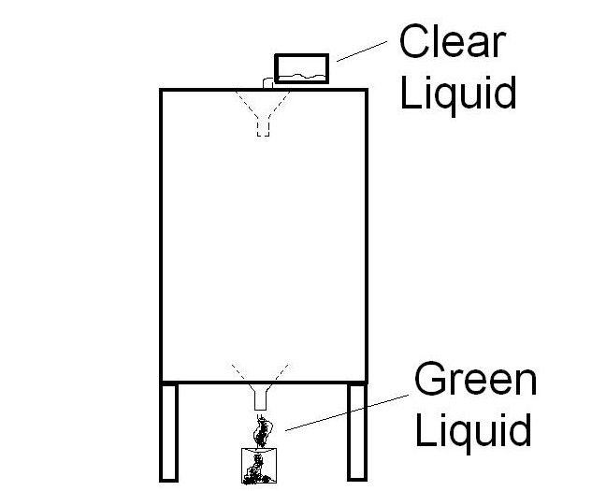
OBSERVATION, INFERENCE, OR PREDICTION?
The teacher poured clear water into the top of the Mystery Box

Slide 35
OBSERVATION

Slide 36
OBSERVATION, INFERENCE, OR PREDICTION?
Green liquid came out of the bottom of the Mystery Box

Slide 37
OBSERVATION

Slide 38
OBSERVATION, INFERENCE, OR PREDICTION?
There might be a tube with food coloring connecting the funnels

Slide 39
INFERENCE

Slide 40

OBSERVATION, INFERENCE, OR PREDICTION?
The person is holding what looks like a gun

Slide 41
OBSERVATION

Slide 42
OBSERVATION, INFERENCE, OR PREDICTION?
The person might be happy

Slide 43
INFERENCE

Slide 44
OBSERVATION, INFERENCE, OR PREDICTION?
I think the person shot a duck

Slide 45
INFERENCE

Slide 46

OBSERVATION, INFERENCE, OR PREDICTION?
The person is going to sing

Slide 47
PREDICTION

Slide 48
OBSERVATION, INFERENCE, OR PREDICTION?
The person has a mustache

Slide 49
OBSERVATION

Slide 50
OBSERVATION, INFERENCE, OR PREDICTION?
The person will sneeze

Slide 51
PREDICTION

Slide 52

MAKE AN OBSERVATION ABOUT THE PICTURE

Slide 53
MAKE AN INFERENCE ABOUT THE PICTURE

Slide 54
MAKE A PREDICTION ABOUT THE PICTURE

Slide 55
